Slide 1

Registries - The What, Why & How?

Slide 2

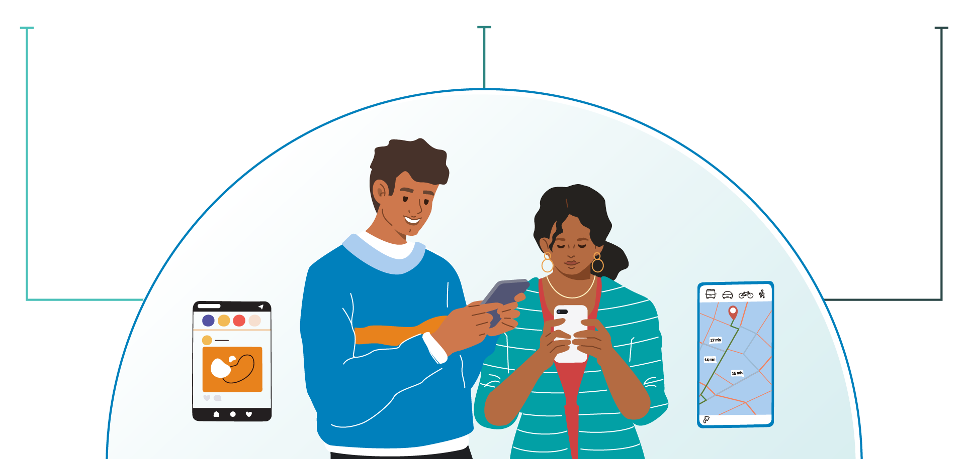
3 pillars of digital economy for inclusive development
DIGITAL IDENTITIES Who I Am
DIGITAL ASSETS What I Have
DIGITAL TRANSACTIONS What I Do
Foundational and Functional IDs, Digital / self-sovereign IDs
Digital money, tokens, assets Digitally verifiable (physical) assets, Data and credentials
Payment, trade/commerce, data/credential sharing, education/jobs, etc. via open interoperable networks
Content of this deck is licensed under CC BY-SA 4.0
Notes:
Quick recap from earlier webinar on the power of registries and credentials by Dr Pramod Varma. The holy trinity that form the foundation of an inclusive digital economy. What if I could prove who I am and carry what I have with me wherever I need it - that would enable me to seamlessly transact. We have already seen how money these days does not need to be carried around in the form of printed notes, rather we can just pay using digital means available to us.
Who I Am - makes it sound obvious that digital identities are for people - they are also for organisations and things. For example, we have company IDs, vehicle registration number, as well as professional IDs, Student IDs, and so on for individuals.
What I Have - are essentially assets and credentials I have. This again seems obvious for individuals to have assets such as money, certificates, ownership records, credentials, tokens, vouchers. Digital assets in context of organisations could be a carbon credit certificate, compliance to industry standards, a govt affiliation school or hospital etc. and for things, take an example of a car having a pollution clearance certification or the energy rating for an electrical appliance.
And when we can easily share & trust the identity and their assets - we can unlock so many transactions with high-trust and low-cost.

Slide 3
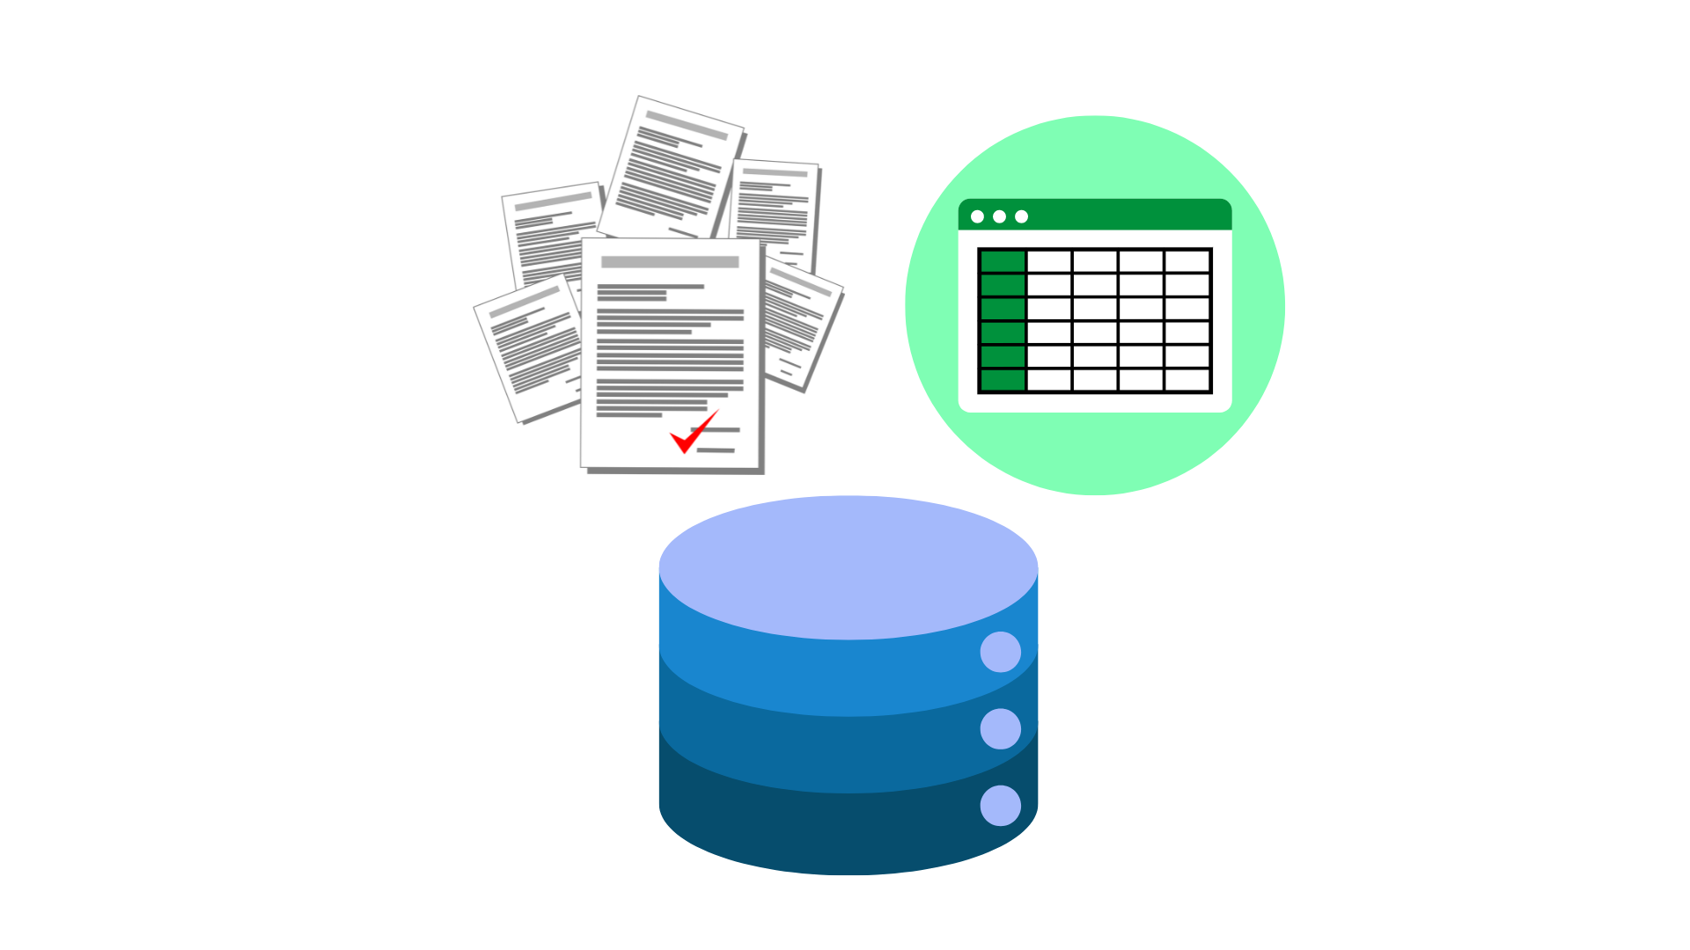




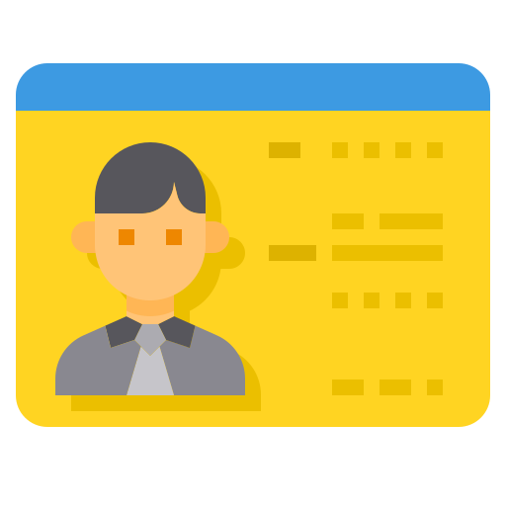
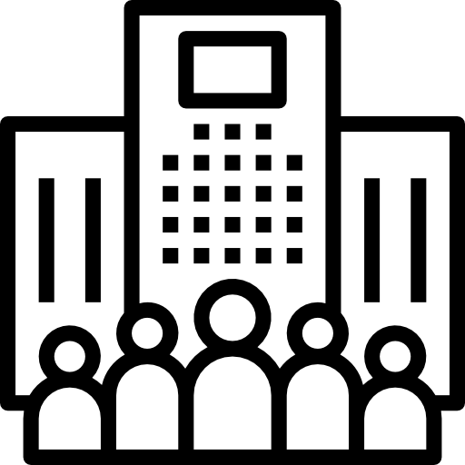

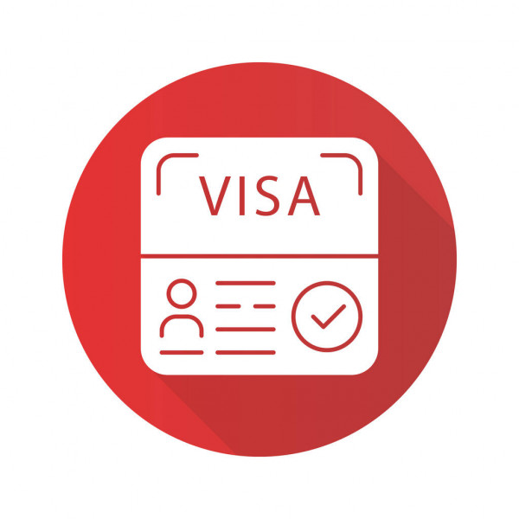

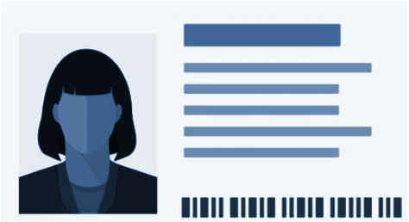
Institutions..
(both govt. & pvt)
have data…
in docs, DBs & spreadsheets...
(Government bodies, Schools, Colleges, Hospitals, Public & Private sector)
(Property records, Employment & Education records, Routine immunization records and so on)
which are obsolete…!
… leading to fragmented digital ecosystems

Slide 4
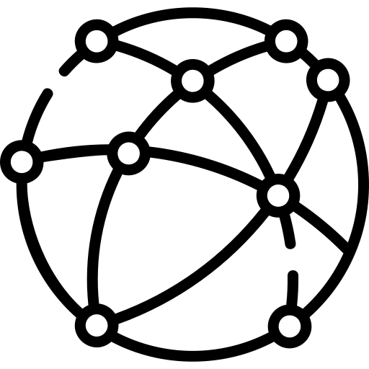

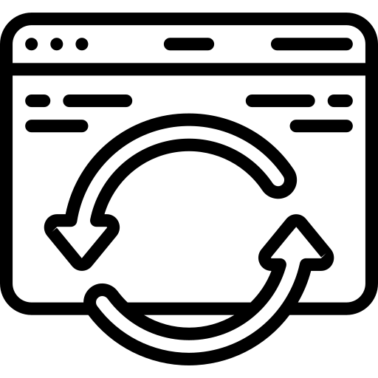

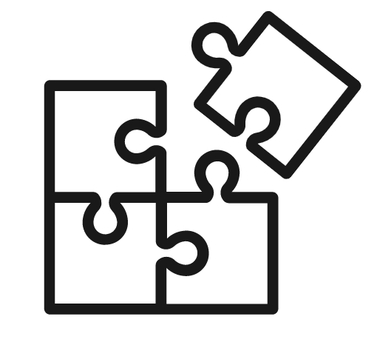

Years of building databases … yet they don’t trigger innovation
No reusability
Fragmentation
Information is re-collected every time it’s needed
Data fragmentation across various disconnected data sources
Governing bodies
Neutrality
Duplication of records
Vendor lock-in
Multiple copies & no single source of truth - waste of money & time!
Outdated information
Restricted silos
Information in the systems are not accurate
Data is restricted to individual
locked systems
Content of this deck is licensed under CC BY-SA 4.0

Slide 5
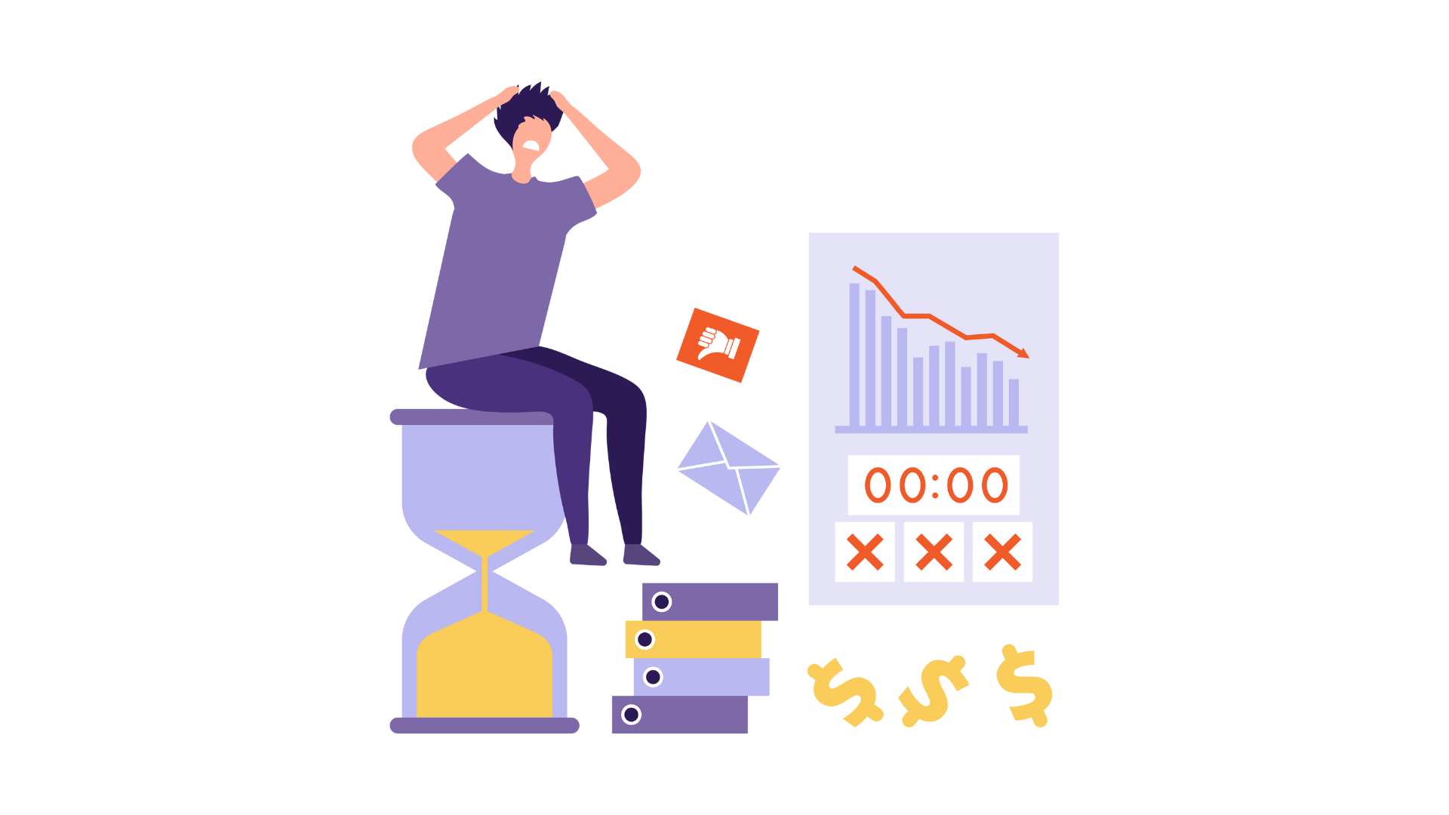
Absence of trusted information hinders service delivery
Innovation suffers when cost of trust is high

Slide 6
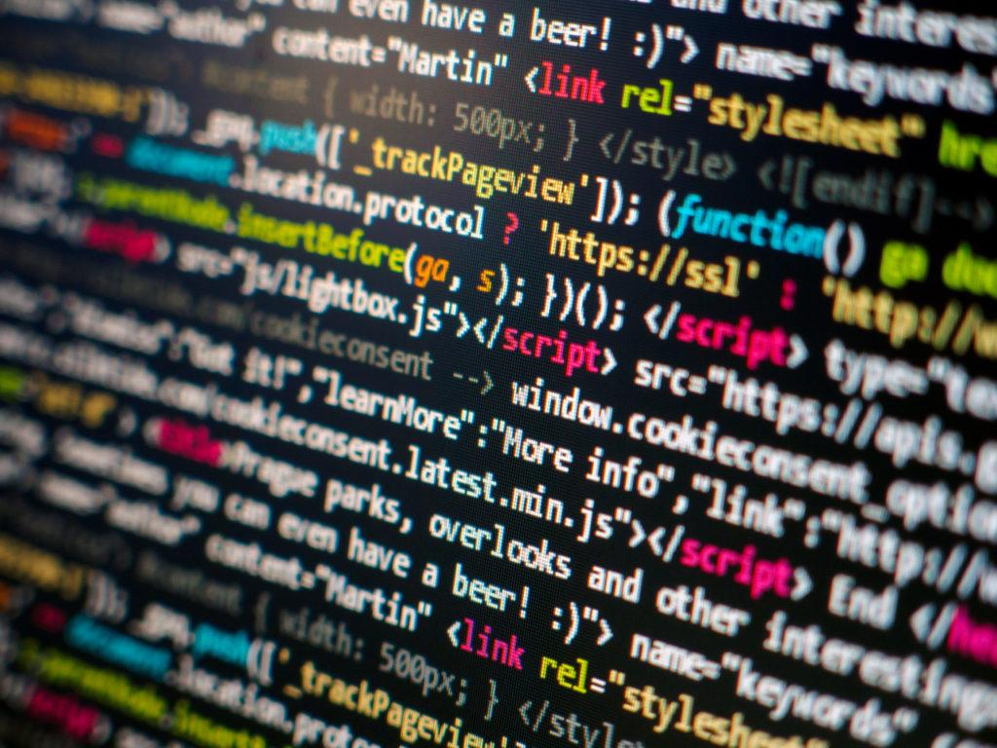
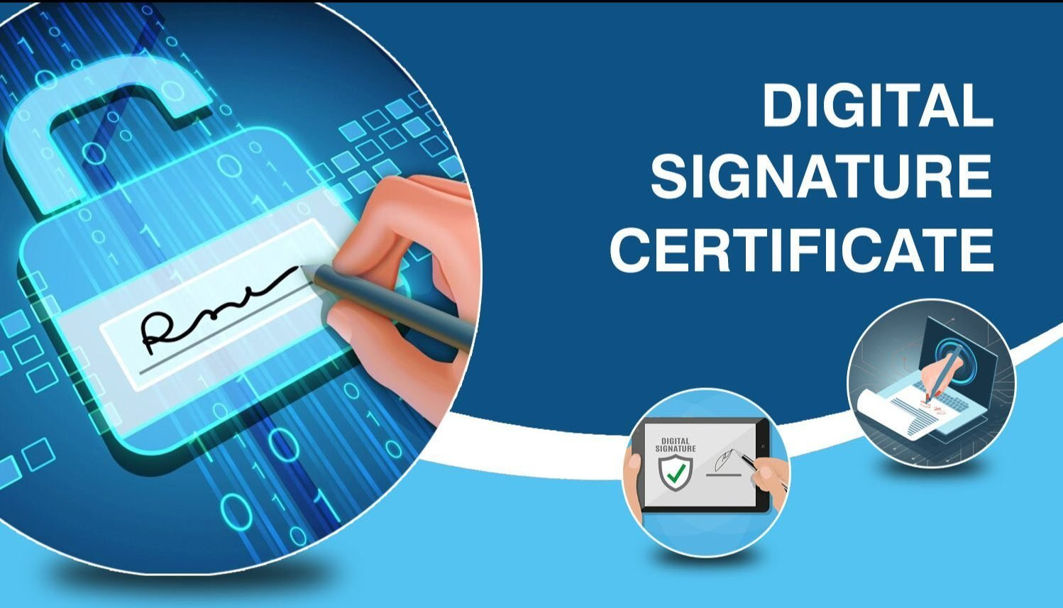
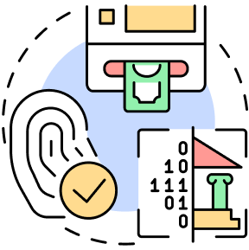
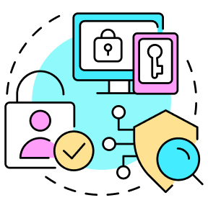
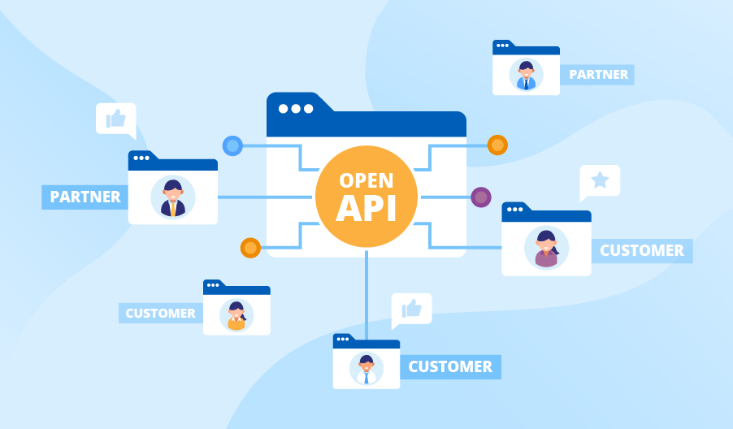
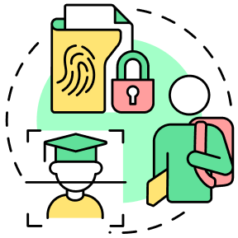
Registries are verifiable sources of truth that are
Machine Readable
Digitally Signed
Accessible via Open APIs
………...intended to create trust in the ecosystem

Slide 7
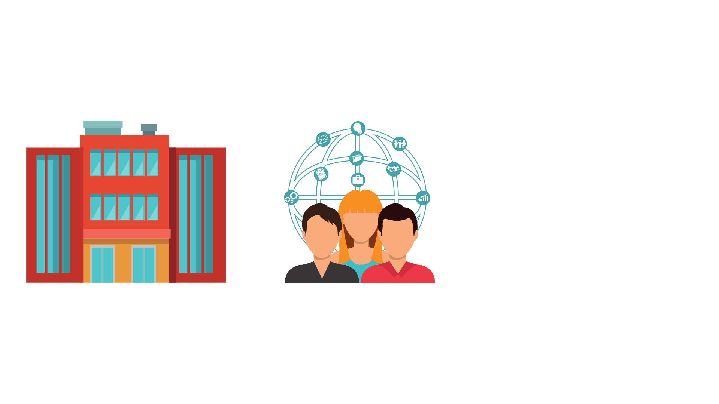

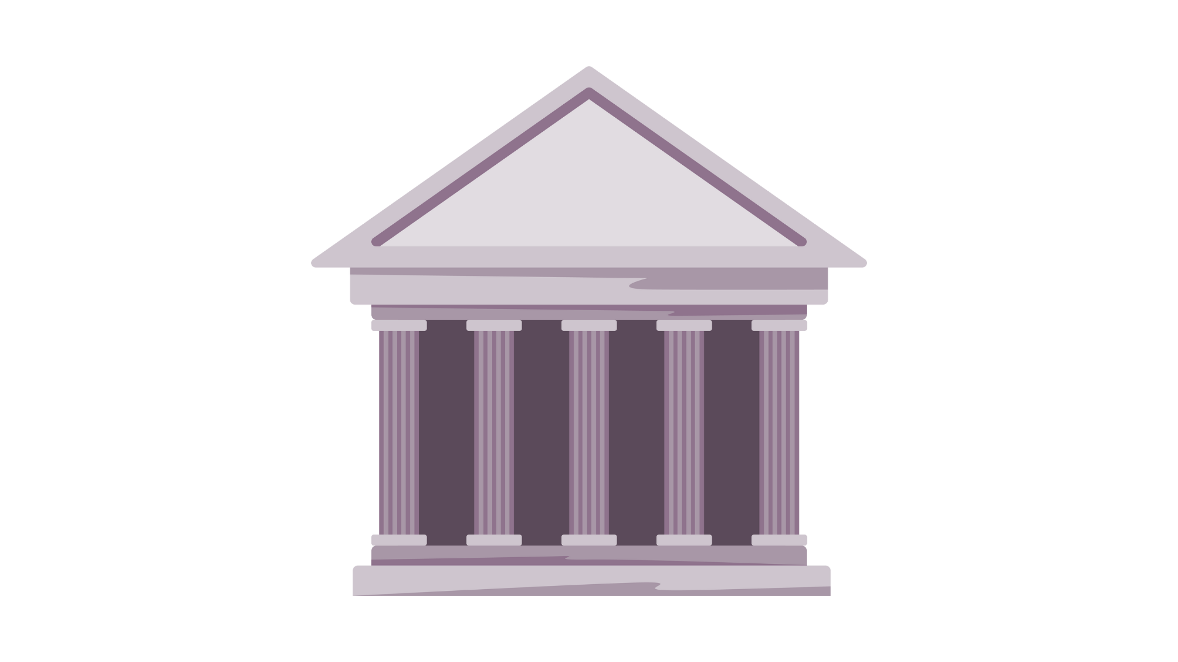
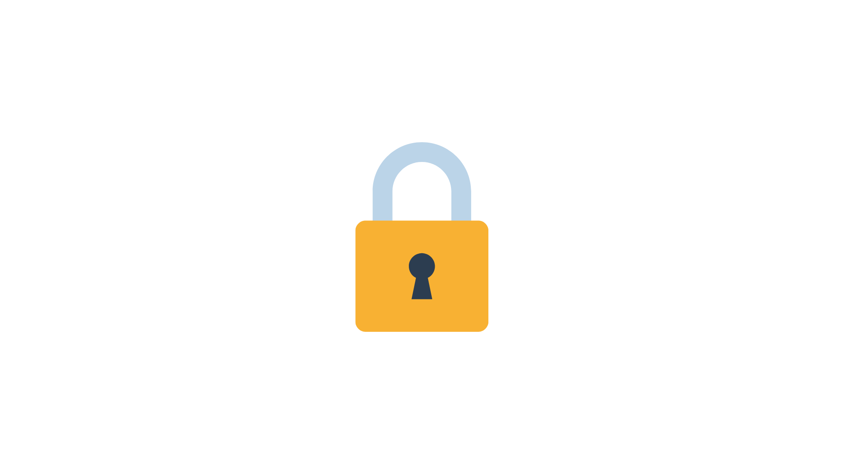
Registries turn
databases into
reusable infra
ensuring it
stays updated
+ Open APIs
Registry
Digitally Signed; Machine Readable
Data
Database
Govt. Dept
Govt. Dept

Slide 8
Bucket of use cases - 1/2
A Healthcare Professional Registry where all health professionals, including doctors and nurses, would be registered and verified, allowing citizens to have access to verified and authentic professionals
A Health Facility Registry where medical institutions are cataloged, enabling patients to find nearby facilities with the services they need, assured of their quality and authenticity
A Farmer Registry that profiles agricultural workers and their land, connecting them with targeted government aid and farming resources.
A Farm/Land Registry that catalogs agricultural properties, aiding in sustainable land use planning and subsidy allocation.
An Organ Registries including Pledge Registry, Recipient Registry, Donor Registry that matches donors with recipients, streamlining organ transplantation processes and saving lives
A Drug Registry that lists approved pharmaceuticals, helping healthcare professionals and citizens
A Vehicle Registry that records all vehicle ownership details, facilitating efficient law enforcement

Slide 9
Bucket of use cases - 2/2
A Government Scheme Registry that connects all eligible citizens with all the welfare programs/schemes run by the government
Educational Registries -Parents searching for accredited educational institutions in their area for their child and being able to compare the programs, ratings, and facilities offered by each.
A Student Registry that tracks academic progress, facilitating scholarship opportunities for students.
A National Identity Registry that securely stores citizen’s identities, simplifying access to public services and enhancing national security.

Slide 10



Thank you!
Centre for Digital Public Infrastructure

